Slide 1




Macrosystems EDDIE: Macro-Scale Feedbacks
Carey, C.C., K.J. Farrell, and A.G. Hounshell. 1 April 2019.
Macrosystems EDDIE: Macro-Scale Feedbacks.
Macrosystems EDDIE Module 4, Version 1.
http://module4.macrosystemseddie.org
Module development was supported by NSF EF 1702506.
Notes:
Welcome students to class. It might be helpful to go around the room and briefly discuss if anyone has experience programming or modeling. The point of this is to emphasize that most students are likely novices, and that asking lots of questions is ok because their peers are novices as well.
It is really important at this point to emphasize that there will be lots of new material covered during this module, and that going slowly and asking for help is very much encouraged!
We generally try to organize the classroom so that students with similar operating systems (e.g., Mac vs PC) can work together; this module asks students to work in pairs.

Slide 2
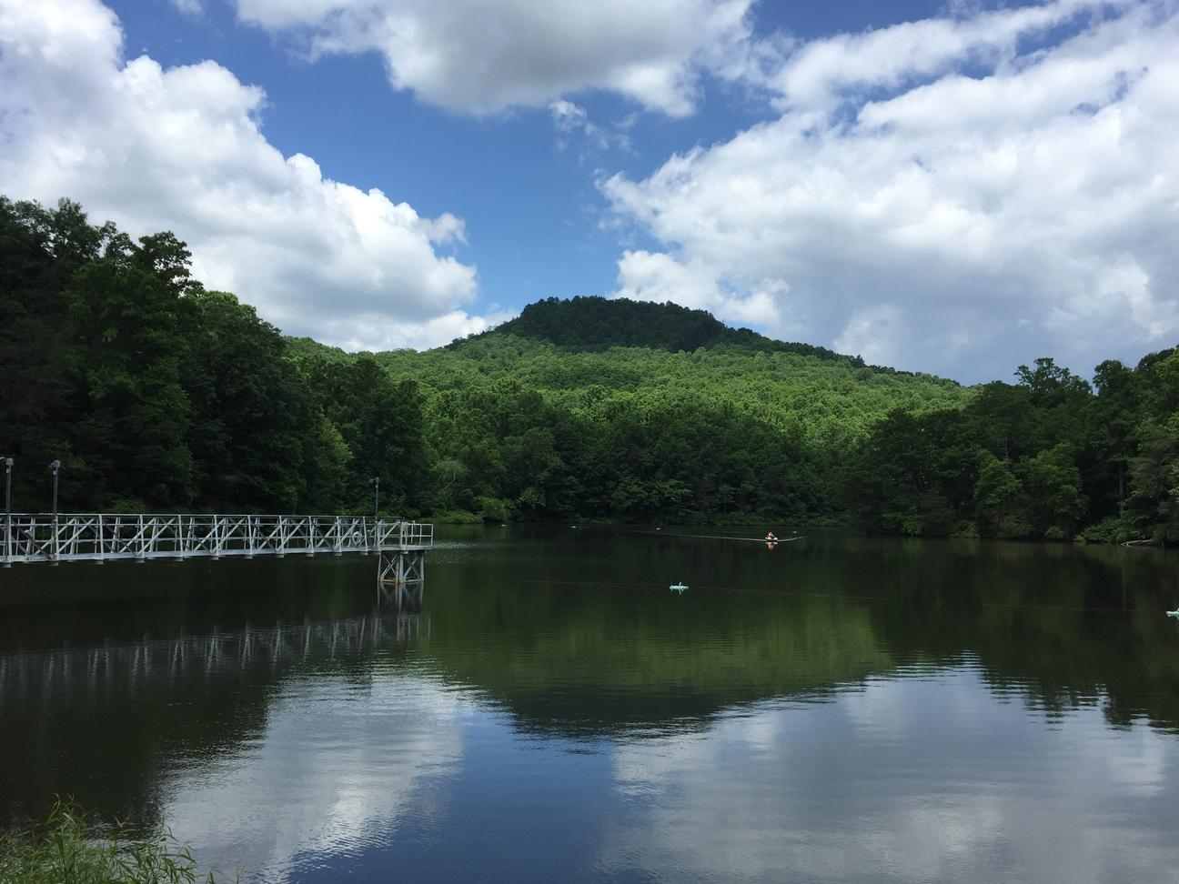
Plan for today:
Short overview on role of lakes in global carbon cycles, and how we can use a macrosystems ecology and lake modeling approach to study how their role may change with climate warming!
Activity A: Run and explore a lake ecosystem model in R.
Activity B: Select a climate scenario, generate hypotheses, and model how lakes respond.
Activity C: Calculate global warming potentials for lakes, and make predictions about the effects of lake greenhouse gas emissions due to macro-scale feedbacks.
C. C. Carey
Notes:
Introduce students to the activities they will complete in class.

Slide 3
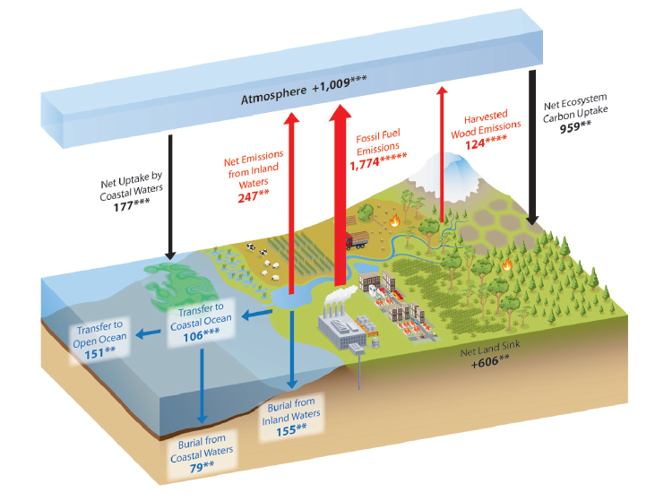
Lakes play a role in global carbon cycles
Lakes absorb, emit, and bury large quantities of carbon (C)
Greenhouse gas emissions (CO₂, CH₄) from lakes can be substantial and may be changing due to human activities
Lakes often not represented in global C cycle, so understudied
Second State of the Carbon Cycle Report (SOCCR), 2018
Notes:
Lakes are really important in the global carbon cycle; estimates indicate they may bury more organic carbon than the deep oceans and may emit more greenhouse gases than terrestrial net ecosystem production.
But, they are often not fully represented in the global C cycle
Today, we’ll model greenhouse gas emissions as carbon dioxide (CO₂) and methane (CH₄) from several different lake ecosystems, first under current temperature conditions and then under different climate warming scenarios. (Tranvik et al. 2009)

Slide 4
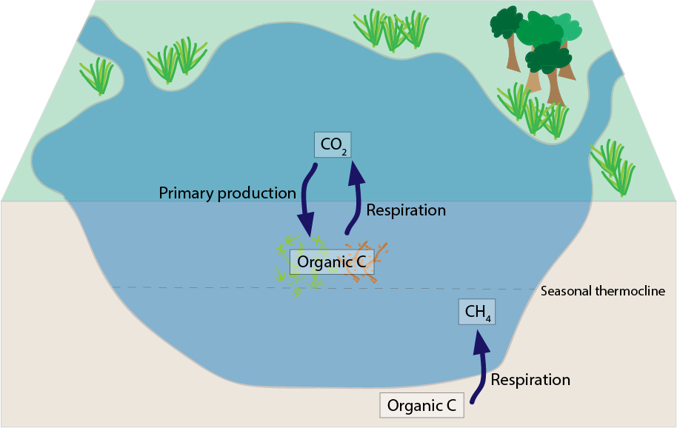
Greenhouse gases (GHGs) in lakes: three important processes
#1
#2
#3
Adapted from Hanson et al., 2015
#1: Phytoplankton take-up CO₂ (carbon dioxide)
#2: Aerobic respiration produces CO₂ if there is oxygen
#3: Anaerobic respiration produces CH₄ (methane) if there is no oxygen
Notes:
Today, we are going to focus on greenhouse gas fluxes as CO₂ and CH₄ from lake ecosystems.
There are three main processes that govern GHG concentrations and ultimately fluxes in lakes:
#1: The first is phytoplankton uptake of CO₂. As phytoplankton grow they use CO₂ and nutrients to produce biomass (organic matter)
#2: Bacterial respiration then breaks down organic carbon to CO₂. This results in release of CO₂. In most lake ecosystems, either phytoplankton or bacterial respiration may be more dominant such that lakes with large phytoplankton growth can be sinks of CO₂ while lakes with high amounts of organic C inputs and low phytoplankton growth may be sources of CO₂ to the atmosphere.
#3: A large part of the GHG fluxes in lakes is from the generation of methane by bacteria under anoxic conditions. This typically occurs when oxygen concentrations are very low. Why might this process occur predominantly in lake sediments?

Slide 5

GHG fluxes in lakes are driven by diffusion gradient across the air-water interface!
Negative flux
Positive flux
Atmosphere > Lake
Lake is SINK of GHG
Atmosphere < Lake
Lake is SOURCE of GHG
NOTE: When there is ice on the lake’s surface, GHG flux = zero because the air and water are not in contact!
Notes:
Now is a good time to review what a flux is (and how we define a positive and negative flux)
Essentially, a negative flux (meaning the lake is absorbing GHG from the atmosphere) occurs when the concentration of the GHG (either CO₂ or CH₄) in the lake is less than the concentration in the atmosphere (as represented by partial pressure or ‘p’). If students remember from chemistry, this is essentially a system trying to get to equilibrium!
A positive flux occurs (when the lake is releasing GHG to the atmosphere) when concentrations of GHG in the lake are more than in the atmosphere.
During the exercise, we will first think about how GHG concentrations in lakes may change under climate change and then predict how fluxes from lakes may change (conceptual diagram on Student Handout pg. 4 and Questions 2-4).

Slide 6
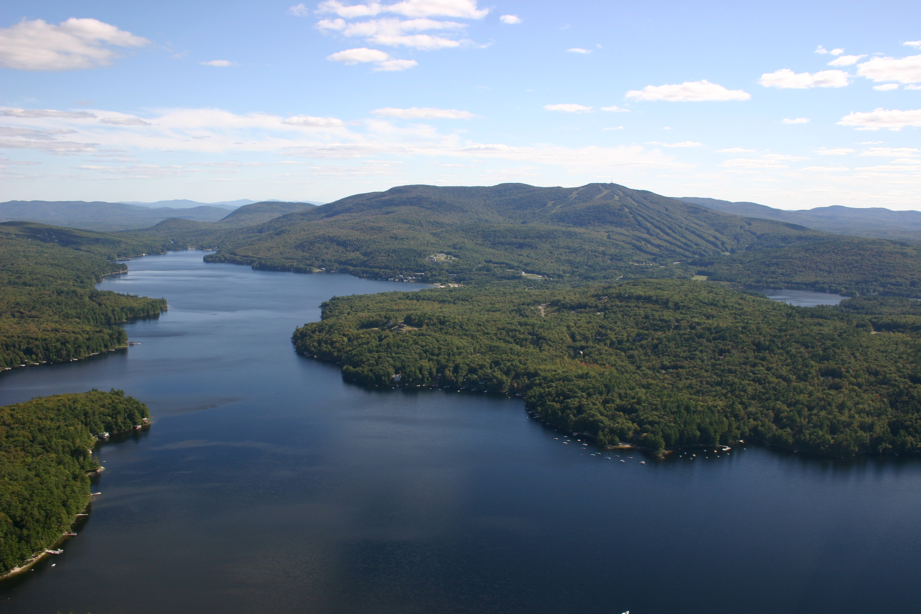
Lake warming may influence CO₂ and CH₄ fluxes: but likely varies among lakes and gases!
Warmer temperatures may increase phytoplankton growth
Warmer temperatures also increase respiration rates
Warming water holds less dissolved oxygen (DO), resulting in lower DO concentrations
Lake Sunapee, NH
R. Kloeppel, Flickr
BUT, how will all of these processes interact?
Notes:
All of the processes that control GHG fluxes from lakes are dependent on temperature, therefore, a warming climate is likely to alter GHG fluxes from lakes.
Warmer surface temperatures are expected to increase both phytoplankton growth and increase respiration rates. An increase in phytoplankton will also lead to an increase in organic matter in the lake, which can further fuel respiration rates both in the water column but particularly in the sediments.
Temperate is also really important in controlling dissolved oxygen concentrations in lakes, which is important for the generation of CH₄.
What we don’t know is how all of these processes will interact to change GHG emissions from lakes!
In this module, we will explore how a warming climate will impact GHG emissions from lakes by modelling each of these processes and seeing how the changes synergistically impact GHG emissions, as CO₂ and CH₄ from lakes.

Slide 7
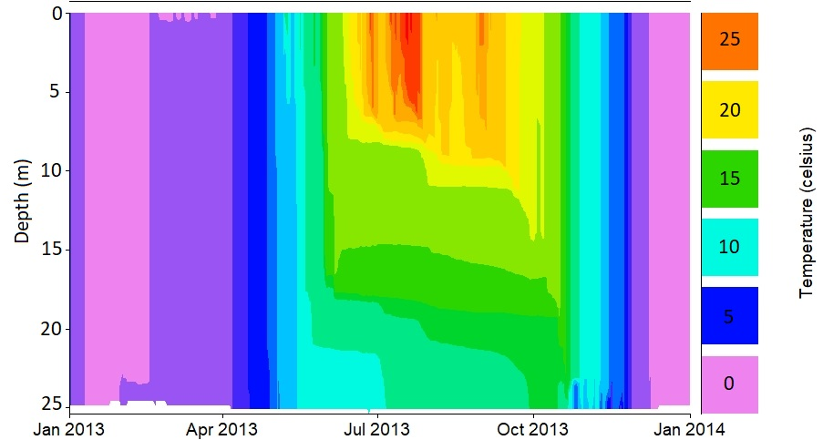
How does lake temperature vary seasonally?
Ice cover
Epilimnion
Thermocline
Changing lake level
Hypolimnion
Lake Mendota, WI, USA: data from Temperate Lakes Long-Term Ecological Research
Notes:
Here are lake temperature data from Lake Mendota, a large dimictic lake in Wisconsin, USA, from 2013.
In the modeling exercise, we’ll start by looking at how temperature and temperature structure change in different lakes under different warming scenarios, as temperature has a very important effect on GHG emissions from lakes. We’ll make many graphs that look like this today.
Tell the students how time is on the x-axis, and depth is on the y-axis (from the surface to the sediments at 25 m depth), with color referring to the temperature, from cold 0ºC (blue) to very warm 30ºC (red). These are called heat maps or thermal plots, and we will be using these types of figures in the module.
When we say ‘lake thermal structure,’ we are referring to both the magnitude of the water temperature in the lake at multiple depths, as well as the stratification pattern.
If a lake is thermally stratified, it exhibits distinct layers of water on a density gradient. In the summer, warmer water on top is less dense than colder water on bottom. Maximum density of water is at ~4ºC: water at 25ºC is substantially less dense than colder water, hence why it is at the surface of the lake.
Note! We are focusing here on thermal stratification, not chemical stratification. Density gradients due to differences in water chemistry (e.g., salinity) can be a major factor altering stratification in some lakes, but we are focusing on thermal density gradients in this module.
We are now going to introduce some terminology:
The epilimnion encompasses the zone of the lake from the surface down to the thermocline, or the depth of maximum temperature change.
The hypolimnion is the lake zone below the thermocline and is the water mass in direct contact with the lake sediments.

Slide 8
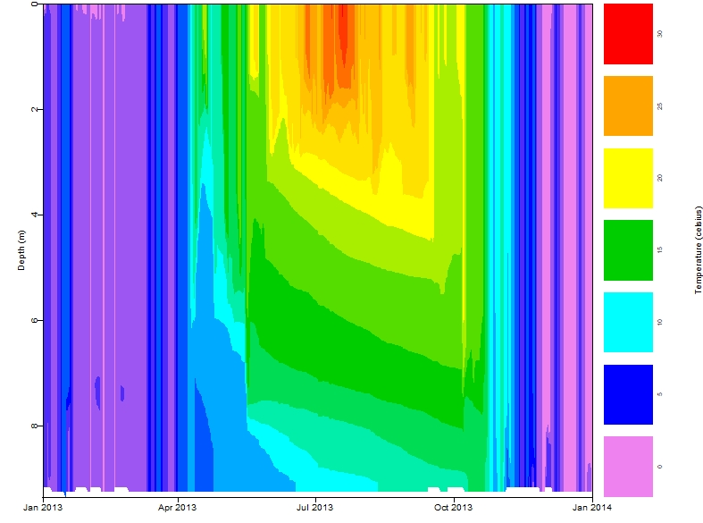
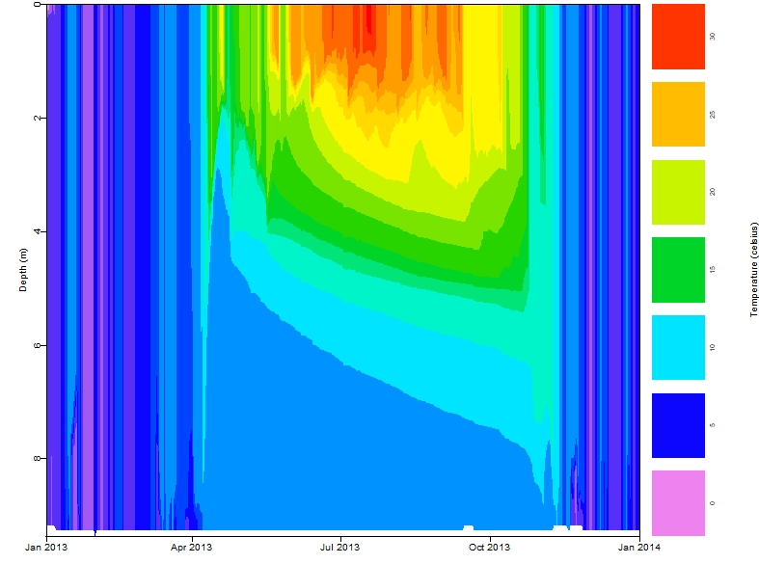
How will warming air temperatures affect water temperatures?
Baseline
+6ºC Climate Scenario
Epilimnion
30
Epilimnion
30
25
25
Thermocline
Thermocline
20
20
15
15
10
10
5
5
Hypolimnion
0
Hypolimnion
0
Warmer epilimnetic waters yet cooler hypolimnetic waters
Model output from Falling Creek Reservoir, VA
Notes:
Here is an example of how warming air temperatures may impact thermal structure in Falling Creek Reservoir in VA (as predicted by models!)
Note that while the surface water temperatures increase, often hypolimnetic waters are predicted to get cooler due to warming air temperatures; this results in more enhanced thermal stratification at the thermocline
How will this thermal structure alter respiration in the surface (oxic) waters? How will this alter respiration in the bottom (anoxic) waters?

Slide 9
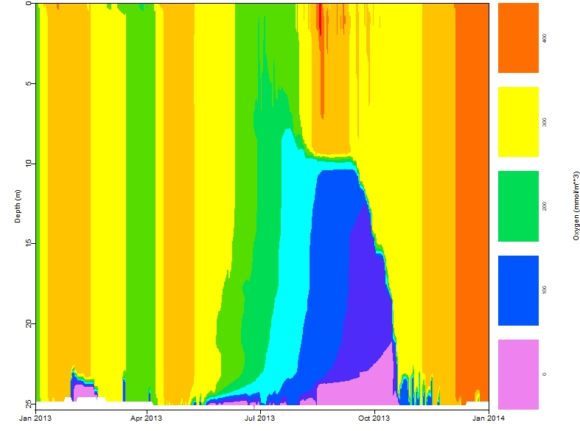
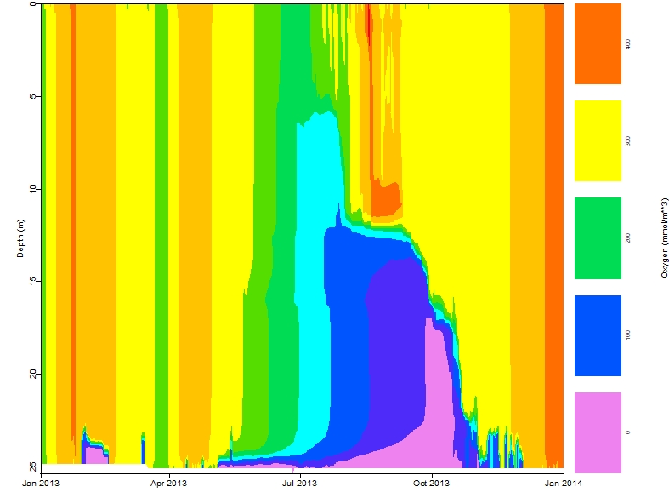
How will warming air temperatures affect dissolved oxygen?
Baseline
+6ºC Climate Scenario
CO₂ will be produced from respiration when there is oxygen
CH₄ will be produced from respiration when there is no oxygen
Lake Mendota, WI: data from Temperate Lakes Long-term Ecological Research
Notes:
Temperature is important in controlling dissolved oxygen concentrations in lakes as well, so in addition to temperature, we’ll also look at heat maps of oxygen.
This is set up the same way as the temperature heatmaps, but instead of plotting temperature, DO is plotted.
In this figure, when do anoxic conditions occur in this lake (Lake Mendota)? Where is this located in the lake?
What happens in October? How does this impact dissolved oxygen concentrations in the water column.
In the +6 scenario, due to enhanced thermal stratification, there is a greater duration of anoxia at the sediments (i.e., more days in the +6 scenario when there is no oxygen at the water-sediment boundary)
How might this impact respiration in the sediments?

Slide 10
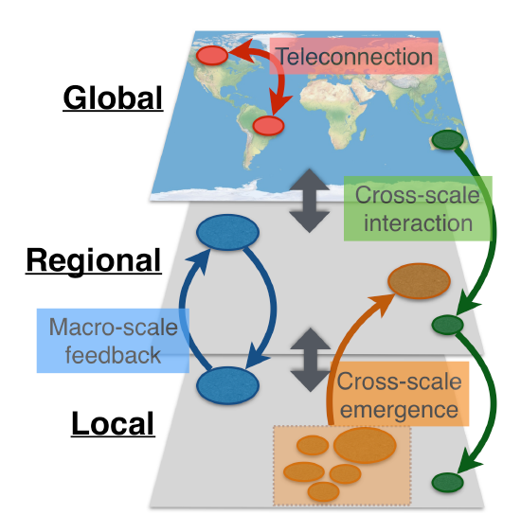
Using a macrosystems ecology approach to study greenhouse gas fluxes
Drivers of fluxes occur at both local and regional scales
Local = e.g., lake characteristics
Regional = e.g., weather
Global = e.g., climate change
Macrosystems ecologists study ecological dynamics and feedbacks at multiple interacting spatial and temporal scales
We can study local, regional, and continental drivers using high frequency sensor data + simulation models
Figure modified from: Heffernan et al. 2014
Notes:
Drivers of GHG fluxes occur at both local and regional scales: e.g., lake characteristics such as phytoplankton concentrations are local factors, whereas weather/climate patterns tend to be regional.
Looking at the effects of drivers operating at multiple scales uses a macrosystems ecology approach, which entails studying ecological dynamics and feedbacks across multiple spatial and temporal scales.
Here, we are using a macrosystems approach combining high-frequency sensor data and simulation models to compare the effects of local and regional drivers on greenhouse gas emissions.
We will also be exploring macro-scale feedbacks to explore how changes in GHG fluxes from lakes under warming conditions will either exacerbate or mitigate future warming.

Slide 11



Macro-scale feedback
Processes occurring at different scales (i.e., local, regional, or global) can either amplify (positive feedback) or diminish (negative feedback) each other
Example:
Local vegetation both influences, and is dependent on, regional precipitation, creating a feedback loop
Evapotranspiration
Heffernan et al. 2014
Notes:
Where a macroscale component can be any driver on an ecosystem that occurs on a different temporal or spatial scale than the macroscale component it has an effect on
I.e., local vegetation cover both influences (through evapotranspiration) and is influenced by regional precipitation patterns, creating a feedback loop (Heffernan et al., 2014)

Slide 12
Macro-scale feedbacks in lakes
Lake GHG fluxes are impacted by: Local lake characteristics and Regional air temperatures
Warming air temperatures, due to climate change, can lead to either an increase or decrease of GHG emissions from lakes
This will result in a macro-scale feedback by either increasing or decreasing GHG concentrations in the atmosphere, which could subsequently intensify or mitigate global climate warming
Global
Climate change
Regional
Air Temp.
Local
Lakes
Lake GHG
Figure modified from: Heffernan et al. 2014
Notes:
We will use ideas in macrosystems ecology to understand how local and regional drives impact GHG fluxes from lakes and explore how the relationship between global temperature and lake GHG fluxes will further alter GHG concentrations in the atmosphere
Ultimately, this will further impact future warming and thus additional GHG fluxes from lakes in the future.

Slide 13
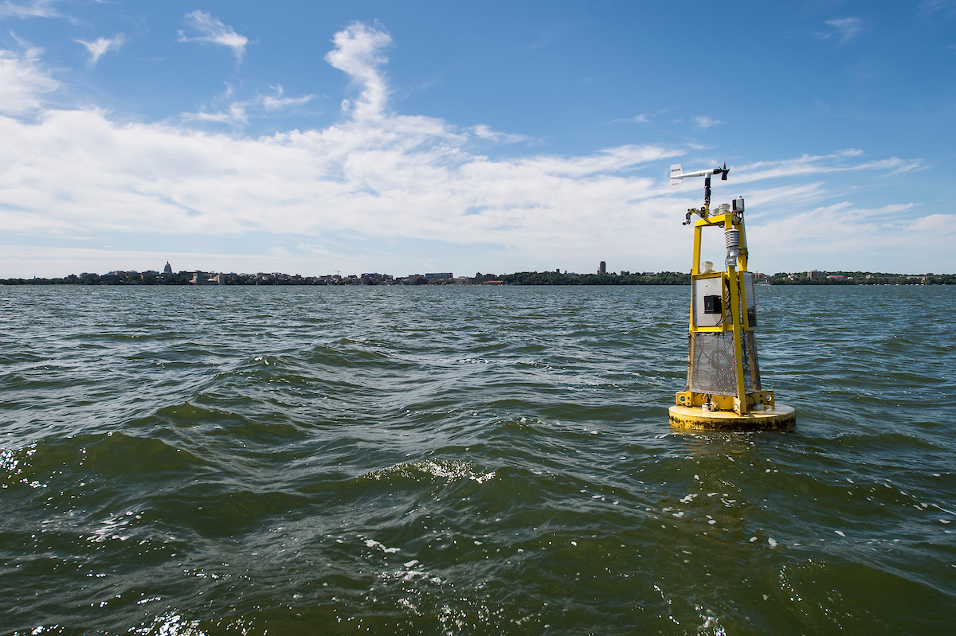
Studying macro-scale feedbacks in lakes is needed to predict future climate change
Lakes play an important role in the global C-cycle
Under warming conditions, lakes may play an even larger role as either a source or sink of GHGs to the atmosphere, but this remains unquantified
May be important in either intensifying or mitigating atmosphere GHG concentrations
BUT, we currently don’t know the answers!
UW-Madison Archives
Notes:
Studying macro-scale feedbacks in lakes is important due to the important role lakes play in the global C-cycle.
Additionally, it allows us to explore whether lakes will play an even larger role as a GHG sink or source under warming conditions.
This will either lead to reduced or enhanced warming in the future.
Emphasize to students that this is a real topic of active ecological inquiry that researchers are working on

Slide 14
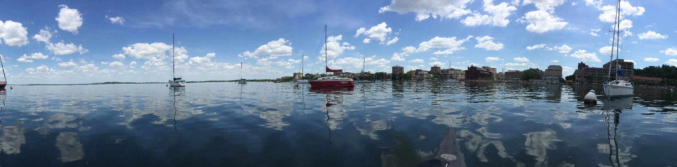
Our focal question:
How will warming temperatures and local lake characteristics interact to create macro-scale feedbacks by altering lake greenhouse gas fluxes?
Image: K.J. Farrell
Notes:
Today, we are going to focus on how warming temperatures and local lake characteristics may interact to create macro-scale feedbacks through the alteration of lake GHG fluxes.

Slide 15
Models to understand macro-scale feedbacks
How can we test the effects of warming temperature and local lake characteristics on GHG emissions?
Impossible to experimentally manipulate all possible climate drivers in real lakes!
Simulation modeling allows us to explore what would happen if we changed one driver, or multiple drivers at once:
For example, how would GHG emissions change if air temperatures were 2°C warmer than they are now? 4°C? 6°C?
How would this change for different lake ecosystems?
GHG
GHG
GHG
+2°C
+4°C
+6°C
Notes:
To study the effects of climate on local lakes, researchers use models, because it is impossible to manipulate factors such as solar radiation and air temperatures on lake ecosystems.
However, simulation modeling allows us to test how changes in one or more drivers alters lake GHG concentrations. Simulation models allow us to manipulate weather and predict GHG emissions, and test the effects of lots of modeling experiments. For example, an experiment could be if air temperatures increased by 2°C.

Slide 16
Global warming potentials (GWP)
Provide a way to compare CH₄ and CO₂ fluxes from different ecosystems on global warming
CH₄ is a more potent GHG (86x more potent than CO₂ over a 20-year time span!)
GWP can be used to convert CH₄ and CO₂ fluxes to the same warming equivalents
Positive GWP = the lake is emitting heat-trapping gases to the atmosphere (intensifying climate change) = NET GHG SOURCE!
Negative GWP = the lake is a net sink for heat-trapping gases and is offsetting global warming = NET GHG SINK!
GWP data from Myhre et al. 2013
Notes:
- A slide to introduce global warming potential – the information is also contained in the R script, but instructors can introduce during the lecture as well.

Slide 17
Global warming potentials (GWP)
We can calculate a lake’s GWP by:
Summing the mass of CO₂ emitted over one year
i.e.) mmol m⁻² d⁻¹ → mmol m⁻²
Summing the mass of CH₄ emitted over one year
i.e.) mmol m⁻² d⁻¹ → mmol m⁻²
Multiply each mass by lake area
i.e.) mmol m⁻² x m² = mmol
Convert units to kg
And scale to GWP
Multiply CO₂ by 1
Multiply CH₄ by 86
Sum CO₂ GWP + CH₄ GWP
NOTE: GWP is unitless!

Slide 18
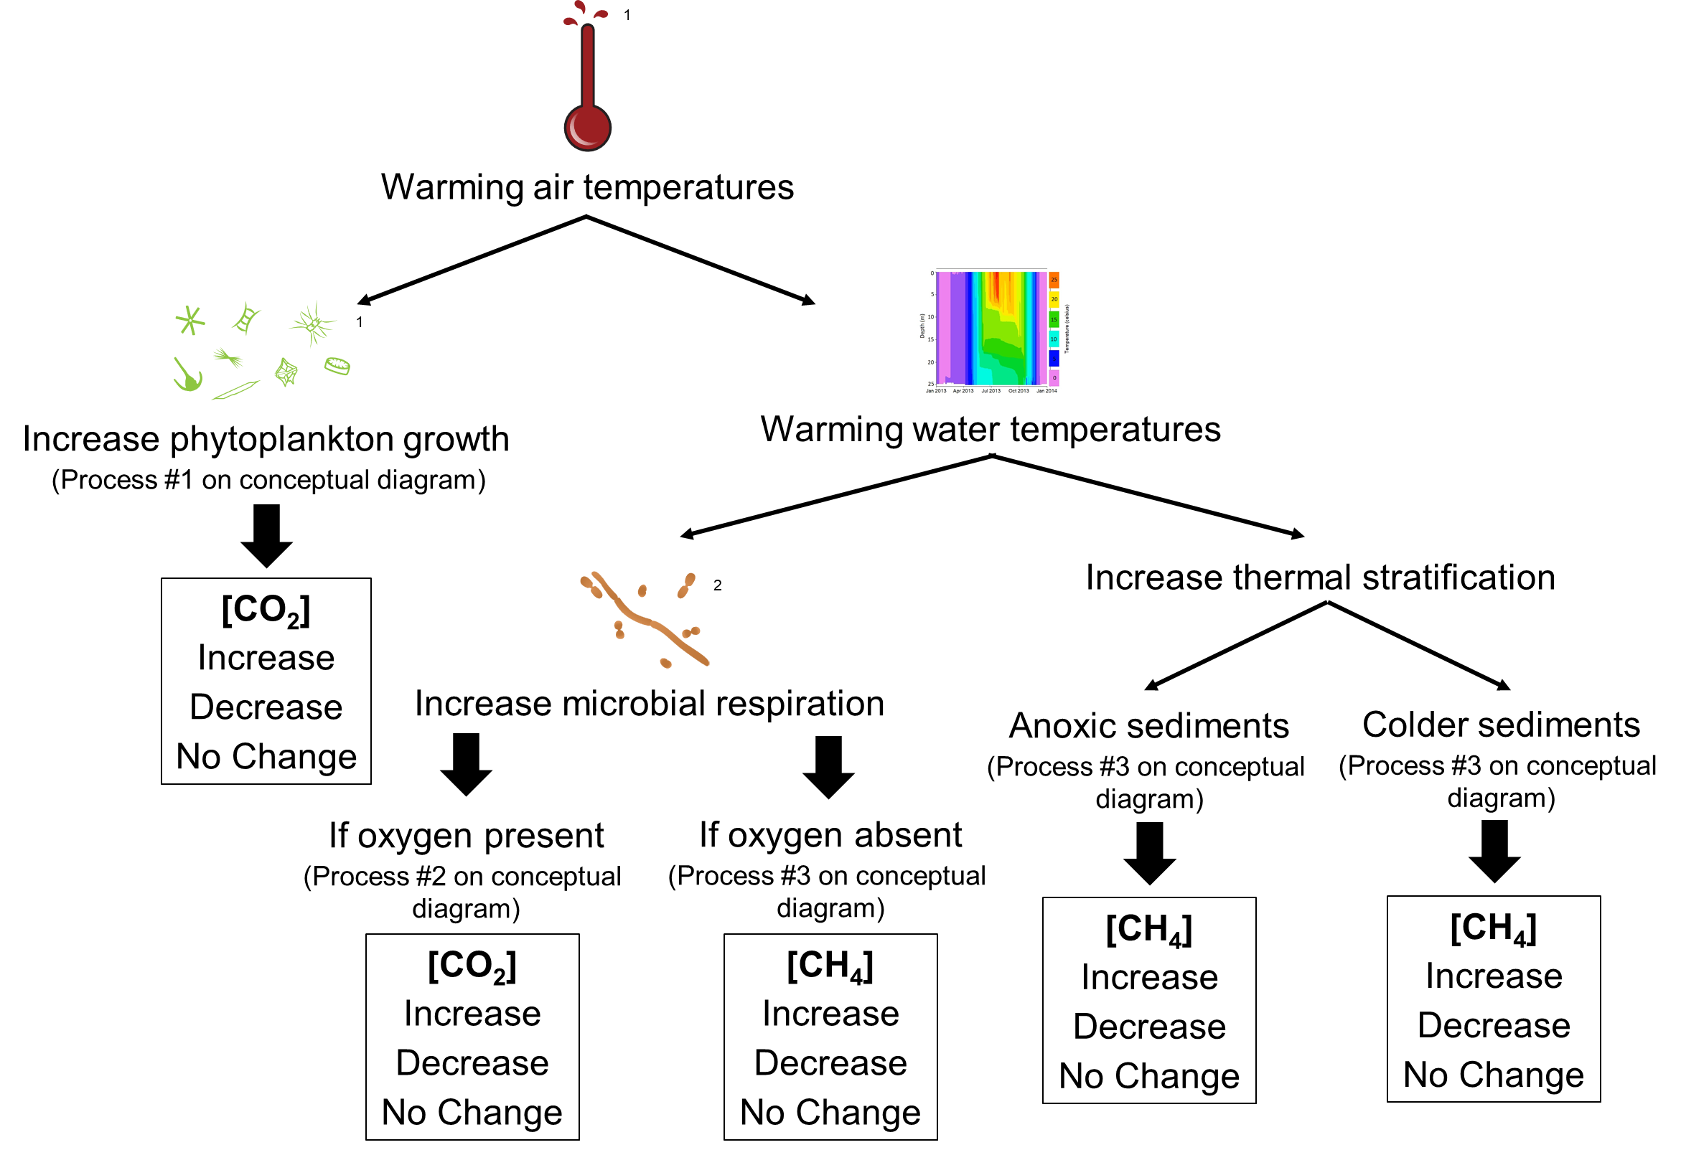
Pre-module activity: Changing GHG concentrations in lakes
Notes:
Before you introduce GLM and R to students, have students complete the pre-module activity in the student hand-out in which they circle their hypotheses from each of the concentrations shown in the boxes. The following slide can be shown while students complete the activity (with their partner!). We recommend discussing answers as a class before moving on. The following slide includes the answers.
NOTE: It is important to emphasize, the goal of this diagram is to think about how INDIVIDUAL processes will influence GHG concentrations in lakes. Therefore, students’ should think about each process as being completely compartmentalized!

Slide 19
Pre-module activity: Changing GHG concentrations in lakes
Notes:
This slide includes answers to the pre-module activity. We recommend discussing answers as a class to ensure all students understand how processes in lakes may change in the future and how this impacts greenhouse gas concentrations. Note: That while we can accurately predict how individual processes will change under climate change, what we don’t know is how the processes will interact to change in the future! This is why we use models: we can use models to see how all of these processes interact to lead to overall changes in greenhouse gas emissions from lakes.

Slide 20


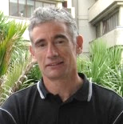
GLM: General Lake Model
Authors: Matt Hipsey, Louise Bruce, and David Hamilton
The General Lake Model (GLM) is an open-access model for simulating lake dynamics. It simulates vertical stratification and mixing and accounts for the effect of inflows/outflows, surface heating and cooling.
GLM has been designed to be an open-source community model developed in collaboration with members of the Global Lake Ecological Observatory Network (GLEON) to integrate with lake sensor data.
Available from: http://aed.see.uwa.edu.au/research/models/GLM/
Notes:
The simulation model we are going to use is GLM (the General Lake Model), which was developed in 2012 as an open-source model by researchers in GLEON, the Global Lakes Ecological Observatory Network.
GLM gives us the opportunity to do climate change experiments, in which we modify different climate conditions and study their effects on the lake.

Slide 21
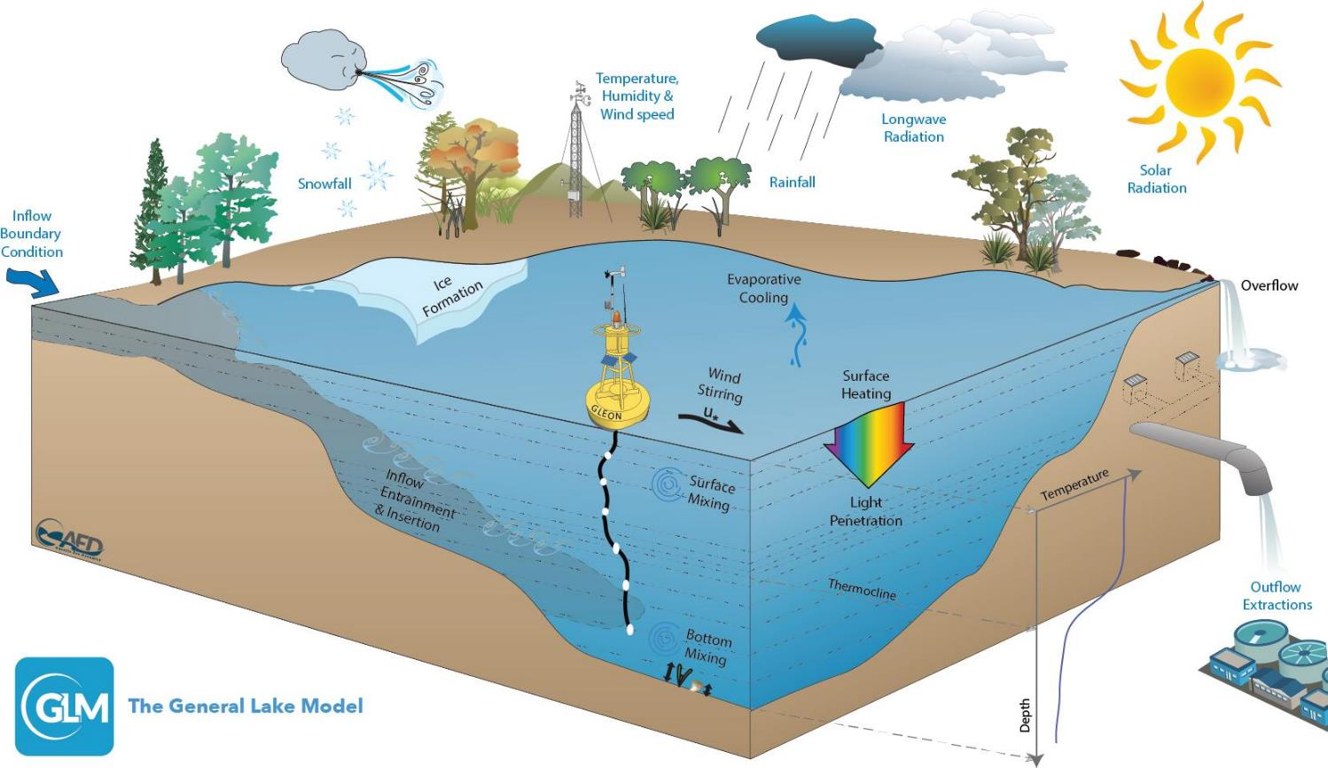
Figure: Hipsey et al. 2019
Notes:
GLM is a lake physics model, which uses climate forcing data as input (e.g., inflows, snow, wind, temperature, humidity, radiation) and models lake thermal structure, with lake temperature profiles as output.

Slide 22
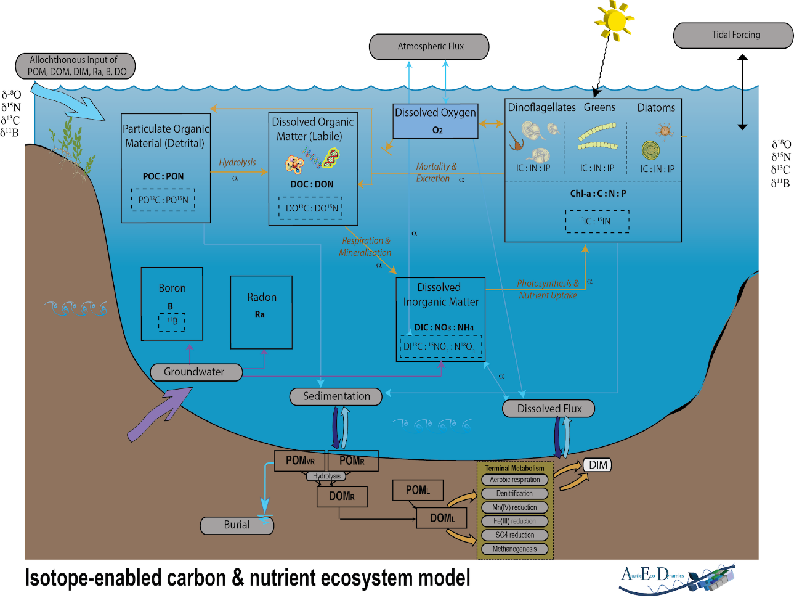
AED: Aquatic EcoDynamics
The Aquatic EcoDynamics (AED) module couples with GLM to model changes in water chemistry and biology
Can model nutrient, phytoplankton, and zooplankton dynamics
Today, we’ll focus on carbon dioxide (CO₂) and methane (CH₄) fluxes at the lake-atmosphere interface
Figure: Hipsey et al. 2013
Notes:
GLM is then coupled with a biogeochemical model that models changes in water chemistry and biology
In this way, we can see how physical changes (temperature) will impact the biogeochemical cycling in many different lake ecosystems.
For this module, we will be focusing on CO₂ and CH₄ fluxes at the lake-atmosphere interface.

Slide 23
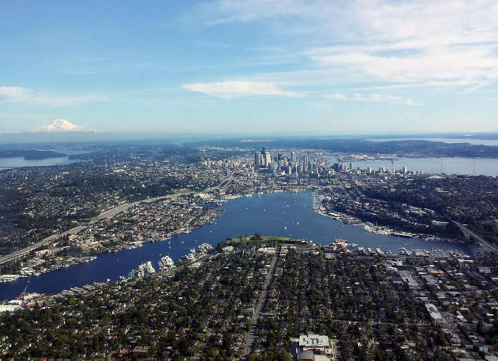
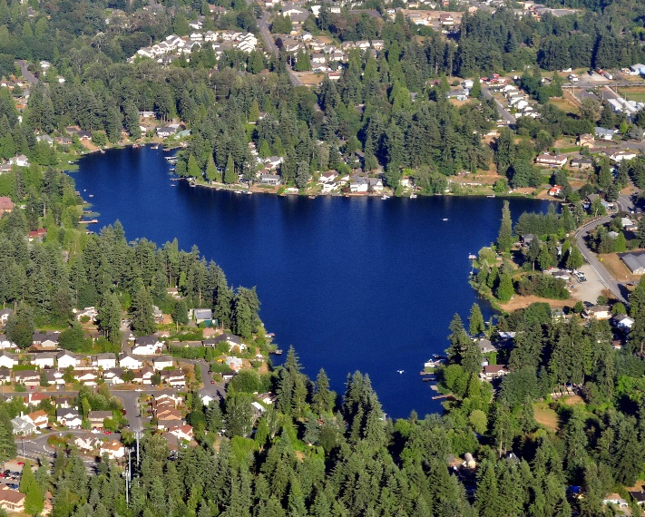
Basic structure of the model
You’ll create a new folder (directory) on your computer when you unzip the module folder.
Within this folder, you will have:
A meteorological CSV (‘met’) file that forces the model (e.g., met_hourly.csv)
‘nml’ text files that act as ‘master’ scripts for the model (e.g., glm2.nml, aed2.nml)
Inflow/outflow CSV files that specify the temperature, flow rate, and nutrient concentrations for streams entering and leaving the lake
Images: Wikimedia commons

Slide 24
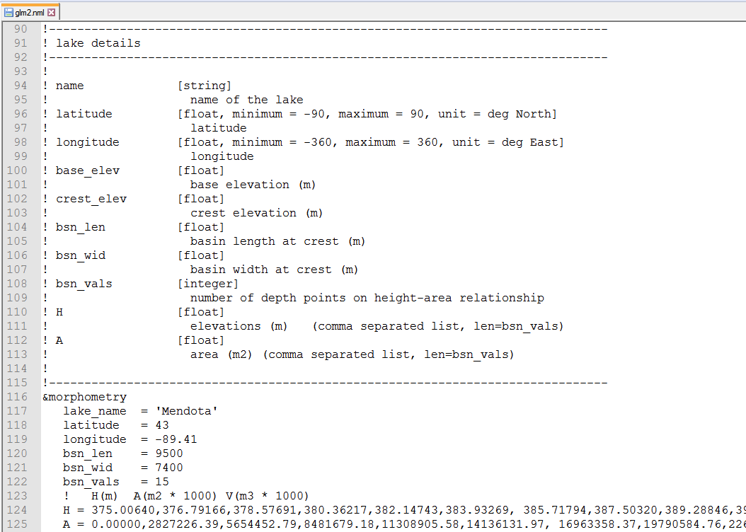
Example .nml file
Notes:
- This is an example of a .nml file which contains information on the lake characteristics. This will be different for each lake we model today.

Slide 25
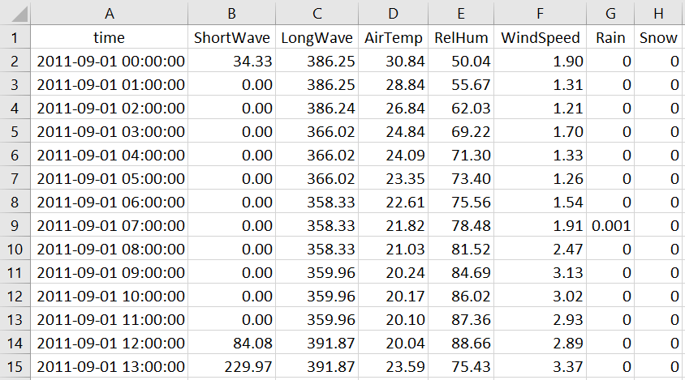
Example met file
Climate scenarios: +2°C, +4°C, or +6°C
Notes:
We also have a met file which contains all of the meteorological information needed to force the model.
We can change the met file to simulate warming conditions, in this case +2, +4, and +6ºC increases in air temperature.

Slide 26

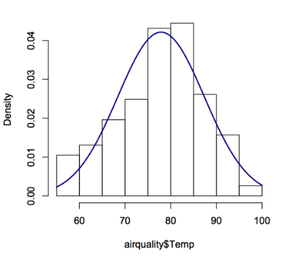
We will run GLM-AED using R
R is a statistical environment that can run on different computer operating systems (PC, Mac, Linux)
R is reproducible, free(!), and easy to download
R can run stats, make figures, and do a suite of different analyses in many disciplines
Many packages for R to merge with other tools (including GLM!)
We’ll walk you through each step of the script, so don’t worry if you’re new to R!

Slide 27
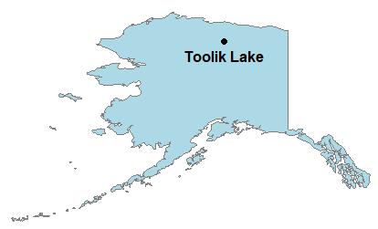


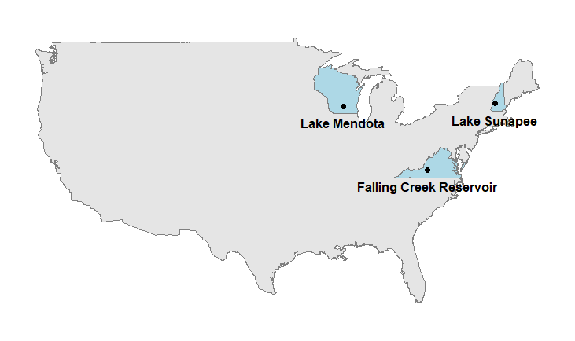

Lakes we’re going to model today, using a suite of available continental datasets
GLEON.org
engr.wisc.edu
Notes:
We’ll focus on four different lakes that each have unique characteristics. All of these lakes have robust, public databases that we will use in each of the models.

Slide 28
Learning objectives
Understand the concepts of macrosystems ecology and macro-scale feedbacks, and how different ecological processes can interact at local, regional, and continental scales
Simulate greenhouse gas fluxes in multiple lakes using ecosystem models set up with publicly-available high-frequency sensor datasets (Activity A)
Test the effects of a climate scenario on the different lake models and examine how the timing and magnitude of greenhouse gas fluxes change with climate warming (Activity B)
Examine how local conditions may alter the timing and magnitude of greenhouse gas fluxes from lakes to affect global climate change (Activity C)
Predict how lake greenhouse gas fluxes may both respond to and amplify changing climate

Slide 29

Discussion questions embedded in
your handout
Everyone will need to turn in the completed handout with question answers written out at the end of the module today.
We encourage you to work with your partner to complete the questions!
Image: newsfrom4j.wikispaces.com

Slide 30
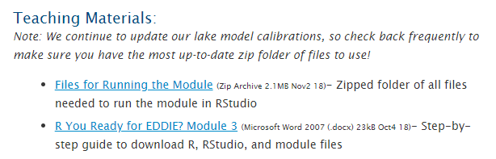
Download the module files
Navigate to the Macrosystems EDDIE Module 4 website
http://module4.macrosystemseddie.org
Scroll down to Teaching Materials and click Files for Running the Module
Save the .zip folder to your Desktop

Slide 31
A few important notes about R
Lines of code that start with # are not read by R
These lines include important notes about how and why the R script is running, so be sure you’re reading them!
Lines with ##!! indicate lines of code where you need to modify something for it to run
In the glm2.nml file, ! indicates lines that are not read by the GLM model (tricky!)
When you need to modify your glm2.nml file in Activity B, make sure you’re not changing the value in a line that starts with a ! or your changes won’t be read by GLM

Slide 32
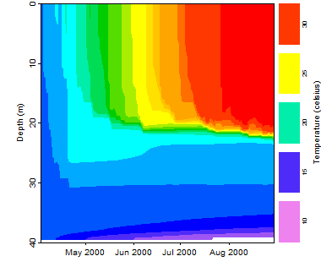
Activity A: Run a lake model!
With a partner (work in pairs):
Find your lake on a satellite map, and examine land use in the watershed
Download the zipped folder of R scripts and other files to run this module. Extract to your desktop
Download GLM-AED files and R packages onto your computer
Run the model and look at the output for water temperature and fluxes of CO₂ and CH₄ for your lake (make sure you save your plots as you go!)
Notes:
Introduce activity A. Allow students to start the activity.
When the majority of students are finished with activity A, then introduce activity B. For those students how take a bit more time, we suggest having faster students assist them.

Slide 33
Activity B: Climate change scenario
Working with your partner, select one of the pre-made climate change scenarios for air temperature. Develop hypotheses about how changing air temperatures may affect water temperatures and greenhouse gas fluxes in your model lakes
Modify your glm2.nml file to test your hypothesis
Analyze the model output to determine how the scenario changed water temperature and fluxes of CO₂ and CH₄
Create a few figures (save them as you go!) to examine your climate scenario:
Does the model output support or contradict your hypothesis?
How does the output from CO₂ and CH₄ compare?
Would you predict more or less warming in the future based on the CO₂ and CH₄ output? Why?
Notes:
- Introduce activity B. Again, when the majority of students have completed Activity B, then introduce Activity C.

Slide 34
Activity C: Global warming potential
Working with your partner, you will now calculate the global warming potentials (GWPs) of your model lake under baseline and warming conditions to assess the relative effect of CH₄ and CO₂ fluxes.
Following the directions in the R script, calculate the mass of CO₂ and CH₄ flux and the GWP of your model lake for baseline and warming conditions. Record these values on your handout.
Create a few figures (save them as you go!) to highlight your 2 scenarios & share with the class!
Do these data support or contradict your hypotheses about the relative importance of CO₂ and CH₄ fluxes on global warming?
What is the net effect of the lake on the atmosphere in the baseline scenario? How might this change with climate warming?
Predict how lake GHG emissions will change future GHG concentrations in the atmosphere. How will this further effect GHG emissions from lakes in the future?

Slide 35
Evidence for Macro-Scale Feedbacks?
GHG emissions from lakes at the local scale interact with regional scale warming conditions.
Lake GHG emissions can further alter global atmospheric GHG concentrations by exacerbating or mitigating a warming climate.
Do you see:
Changing GHG emissions from lakes under the warming scenario?
Changing GWP of lake emissions under the warming scenario?
Given the changes in lake GHG emissions you observed in this module due to macro-scale feedbacks, how do you expect lakes will affect global climate change in the future?
Notes:
As a final check-in, ask students if they believe they have observed macro-scale feedbacks. A macro-scale feedback occurs when GHG emissions from a lake significantly changed under warming conditions resulting in either a predicted increase or decrease on future global temperature. For most lakes, there is an increase in the GWP under future warming conditions compared to baseline. This will result in additional atmospheric warming which will further enhance warming in the future. This will, in turn, exacerbate GHG emissions from lakes. For Lake Sunapee, the model indicates the GWP will decrease such that Sunapee becomes a more significant sink, this will result in a decrease in future warming and a further decrease in GHG emissions from lakes.
Challenge students to think how the cumulative GHG emissions from all of these lakes combined will change in the future. Overall, will there collectively be more or less GHG emissions from lakes in the future? How will this impact climate?

Slide 36

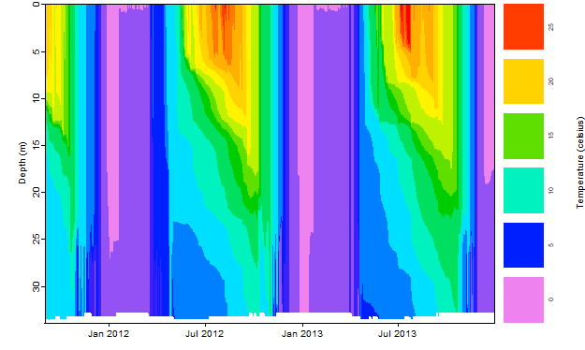
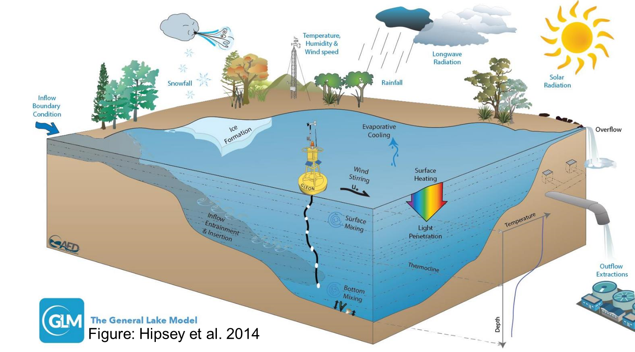
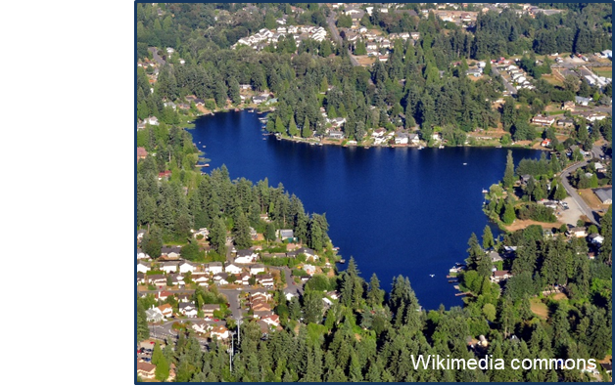
Thank you for participating!

Slide 37
Additional slides for instructors to use

Slide 38
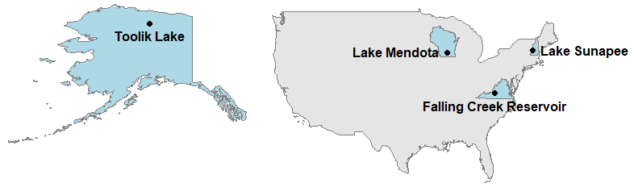
Model lake descriptions
Lake Name | Falling Creek | Mendota | Sunapee | Toolik
State (USA) | Blue Ridge, Virginia | Madison, Wisconsin | Sunapee, New Hampshire | Alaska
Latitude & Longitude | 37.30, -79.84 | 43.11, -89.42 | 43.38, -72.05 | 68.63, -149.61
Mean annual temperature (°C) | +13.9 | +7.9 | +7.5 | -8.0
Surface area (km²) | 0.12 | 39.39 | 16.74 | 1.46
Water quality | Eutrophic (high nitrogen & phosphorus) | Eutrophic (high nitrogen & phosphorus) | Oligotrophic (low nitrogen & phosphorus) | Oligotrophic (low nitrogen & phosphorus)
DOC (mg L⁻¹) | 2.59 | 4.87 | 2.00 | 5.02
Data providers | C. Carey & GLEON | P. Hanson, North Temperate Lakes Long-Term Ecological Research, & GLEON | K. Weathers, Lake Sunapee Protective Association, & GLEON | G. Kling, Toolik Long-Term Ecological Research, & NEON
Notes:
It may be beneficial to introduce the lakes students will be modeling (this is similar to information as contained in the student handout)
For students not as familiar with lake dynamics, it might be worth having a discussion about lake characteristics that influence when/if a lake goes anoxic during the summer (this is important in understanding GHG concentrations and fluxes from lakes)
For instance, Lake Sunapee is oligotrophic meaning it has low organic matter inputs; this leads to low respiration rates in the bottom water such that the bottom waters never become anoxic (which limits the production of CH₄!).
Toolik is also oligotrophic but unlike Sunapee does become anoxic in the summers. This is likely a reflection of the DOC values in the lake! DOC values are an indication of organic matter input, so Toolik still has enough organic matter in it to fuel respiration and still become anoxic in the summer.
On the other hand, both Falling Creek and Mendota are eutrophic and they have lots of organic matter production = anoxia!

Slide 39
Presentation guidelines
Please put together a quick, 5-minute presentation on your baseline + climate scenario results for your individual lake and selected climate scenario
We suggest you include:
A temperature heatmap of your baseline + climate scenario
A DO heatmap of your baseline + climate scenario
Ice thickness for your baseline + climate scenario
CO₂ and CH₄ flux for your baseline + climate scenario
GWP for your baseline + climate scenario
We’ll use question #15 in the student handout to guide discussion about your results!
Notes:
Notes: These are general guidelines we give our students when making their in-class presentations, but feel free to modify as you see fit!

Slide 40
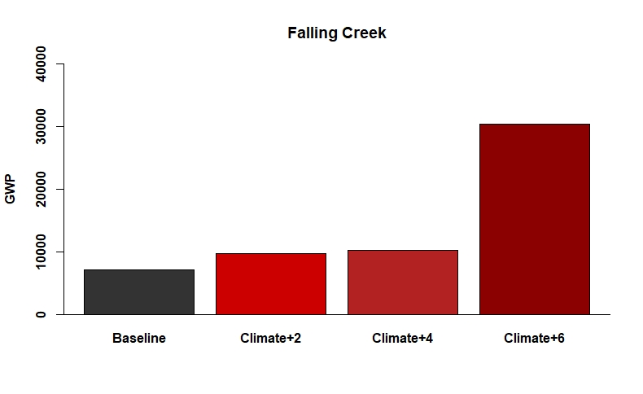
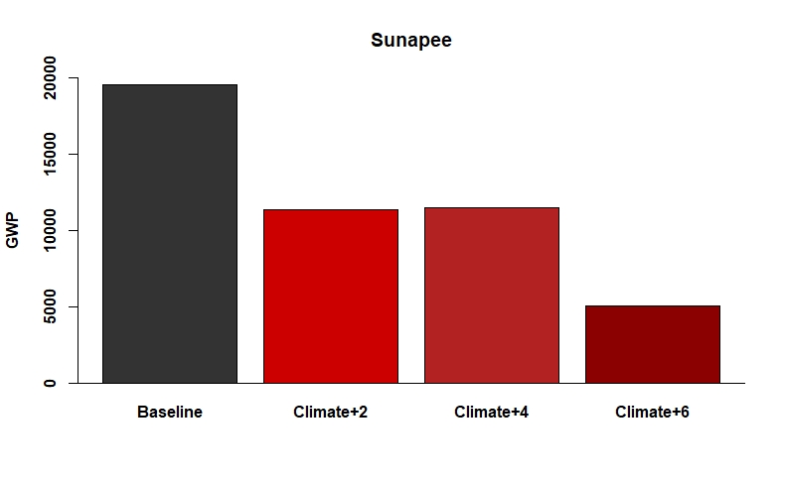
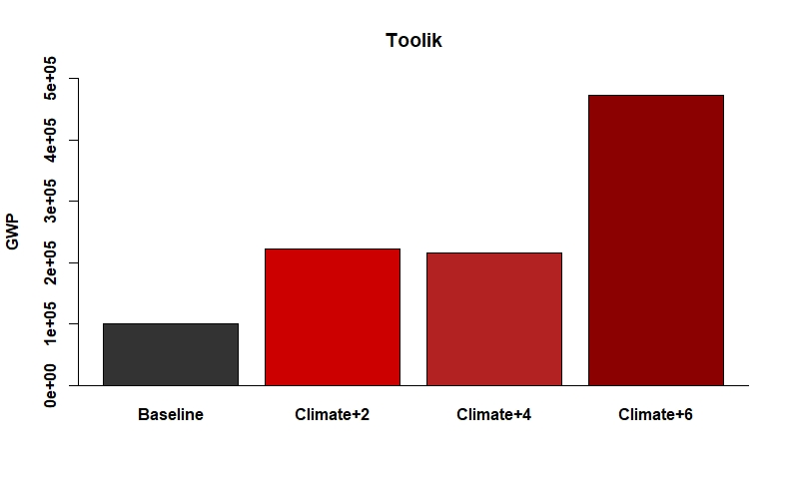
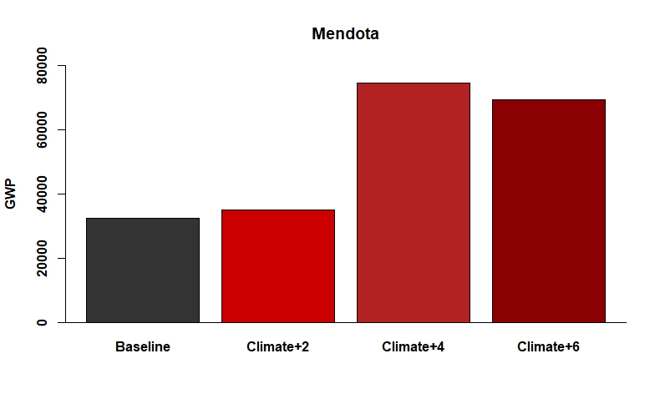
Activity C: Lake GWPs
Notes:
If students are unable to complete Activity C, instructors can use the following slides to facilitate discussion on how the GWP of the study lakes (Falling Creek, Sunapee, Mendota, Toolik) will change under future climate conditions
These graphs are similar to graphs students’ would generate through the activity, but all potential climate scenarios are plotted on the same graph. Discussion points for these graphs are included in the instructors manual.

Slide 41
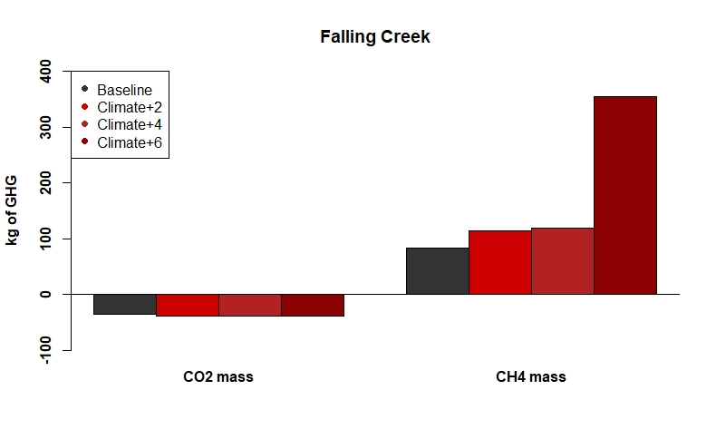
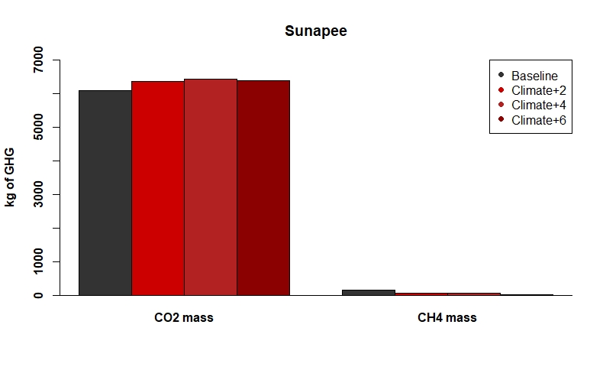
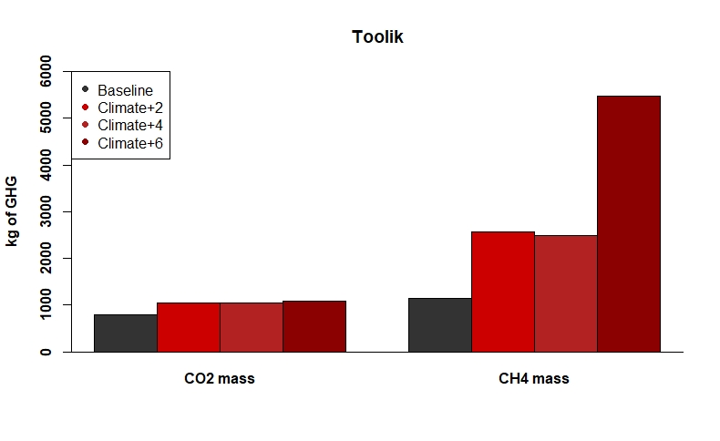
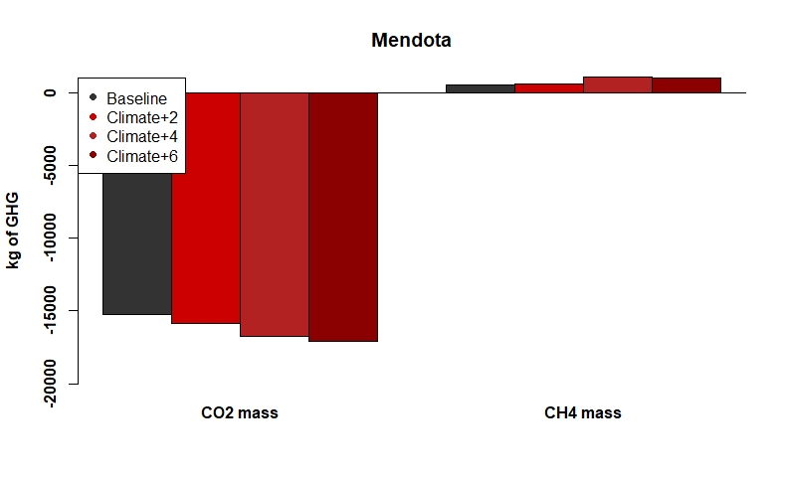
Activity C: Lake Greenhouse gases
Notes:
The following graphs can be used to interpret how the GWP of lakes respond to changes in greenhouse gas fluxes from the different lakes (as methane and carbon dioxide). These graphs can be useful in interpreting which ecological controls may be increasing or decreasing the GWP of lakes in the future.
Discussion points and interpretations for these graphs are included in the instructors manual

